Slide 1


Slide 2
What is Paws Up Profs?
PUP is an organization of UH faculty helping to spread the word about campus-wide events and encouraging Cougar spirit. Typically, we don’t plan the events, but we are helping to share the information.

Slide 3



You make us Cougar Proud!
Congrats to our Olympic Cougars!
Image Source: UH Athletics Facebook Page

Slide 4
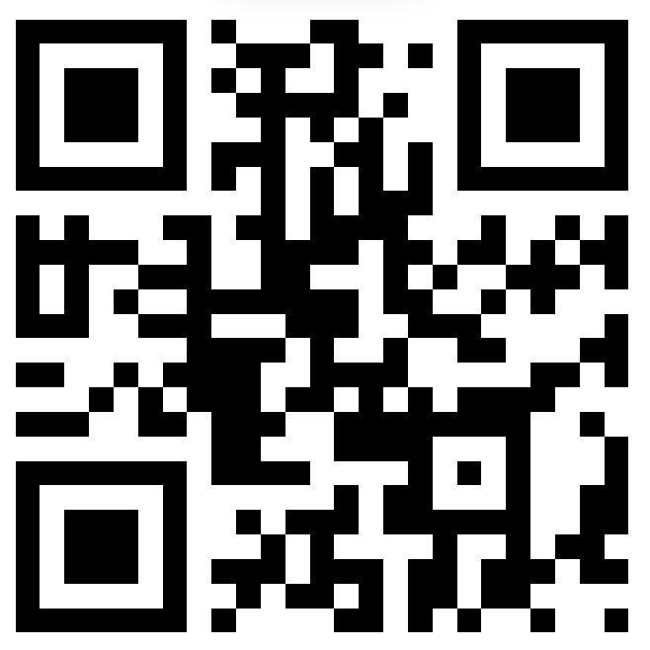
WEEKS OF WELCOME!
SO MANY awesome events for all new and returning students!
Scan the code for details or visit uh.edu/wow
Giveaways
Free Food
Parties

Slide 5
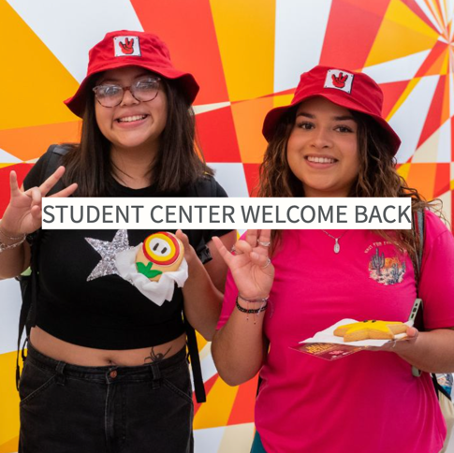
Tuesday Daytime
Tuesday, 8/20: Student Centers Welcome Back
11 am – 1 pm
Trail mix station
Balloon animals
Music
Arts & crafts
Food & giveaways
Free film at 1:30 pm (Jumanji: The Next Level)
uh.edu/wow

Slide 6
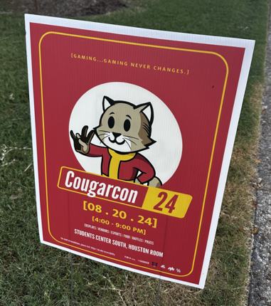
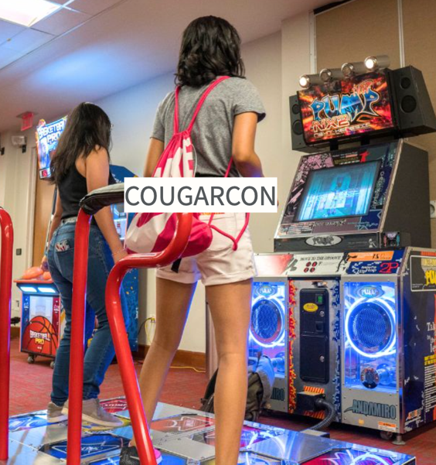
Tuesday Evening
Tuesday, 8/20, 4 – 8 pm
Student Center South
Anime
Cosplay
Game stations
Student vendors
Free food
E-sports
uh.edu/wow

Slide 7
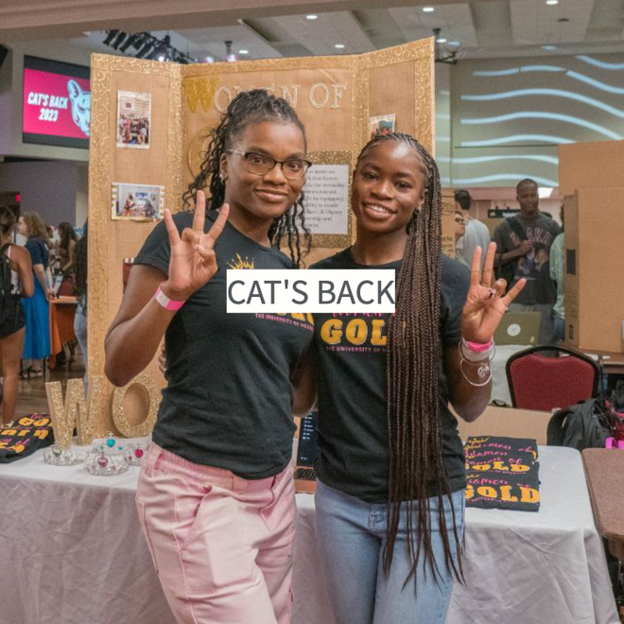
Wednesday & Thursday
Wednesday & Thursday, 8/21 & 8/22
4-6 pm: Student Center South
Get connected to hundreds of student organizations
Free food
Prizes
uh.edu/wow

Slide 8

Thursday Night
Thursday, 8/22, 8-11 pm: Lynn Eusan Park (or Student Center if raining or extreme heat)
Electronic dance music
Glow items
Glow paint
Free food & giveaways
uh.edu/wow

Slide 9

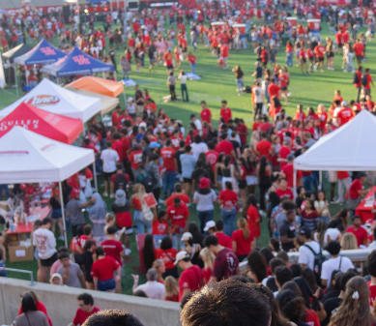

Cage Rage This Friday!!!
August 23rd, 6:30 – 9:30 pm, TDECU Stadium
DJ Yobi Yobz
Inflatables & Games
Selfie Stations
Prizes, Snacks, & Drinks
Pep Rally w/Houston Cougar Football & Fireworks
uh.edu/wow
Enter stadium through Gate 2 for FREE PARKING IN LOT 12A
Image Source: University of Houston Athletics & UH Calendar & UH Weeks of Welcome Website

Slide 10
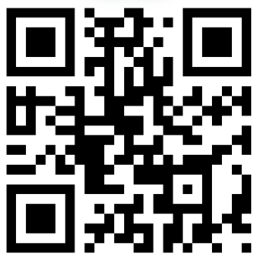
COMING UP NEXT WEEK:
Cultural Taste of Houston (Tuesday)
Commuter Movie Night (Tuesday)
Rec Fest (Tuesday)
Shasta’s Open House (Wednesday & Thursday)
Welcome to Houston (Wednesday)
Greek-a-Palooza (Wednesday)
Shasta’s Night Out (Thursday)
WOW Day of Service (Friday)
Healthy Tailgate (Saturday)
WEEKS OF WELCOME!

Slide 11

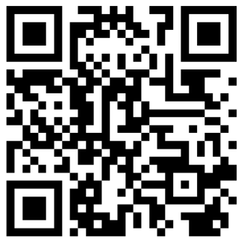

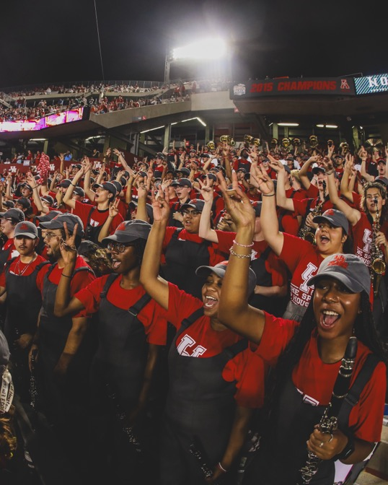
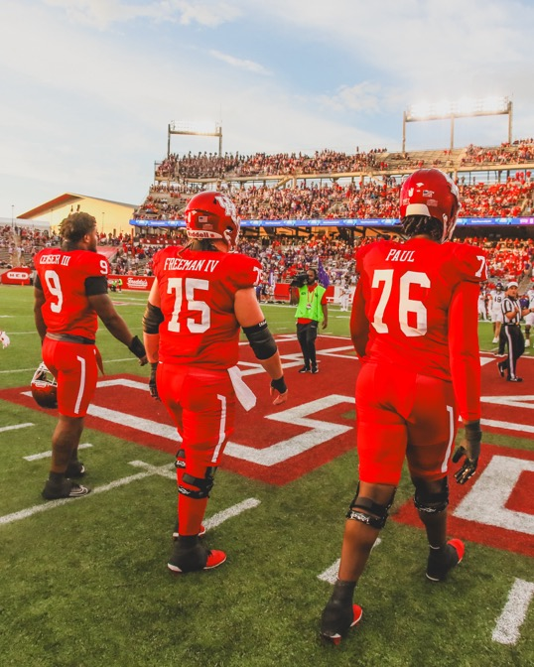
Cheer on our Coogs at the 1st Game!

Slide 12
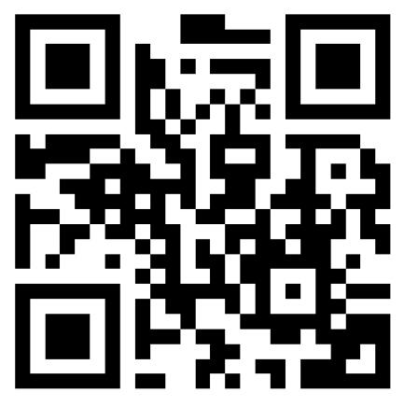
Upcoming Athletic Events
UHCougars.com

Slide 13

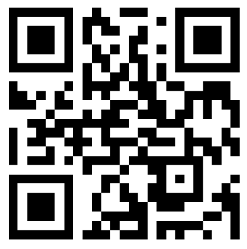
Show Your Cougar Spirit
Find info about:
Red Friday Selfie Spots
T-shirt giveaways
UH Dining
Challenges and contests
uh.edu/dsa/crf/

Slide 14

SAVE THE DATE

Slide 15
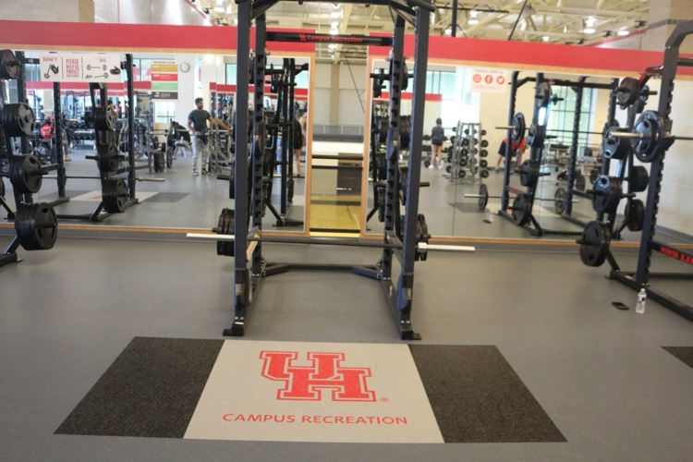
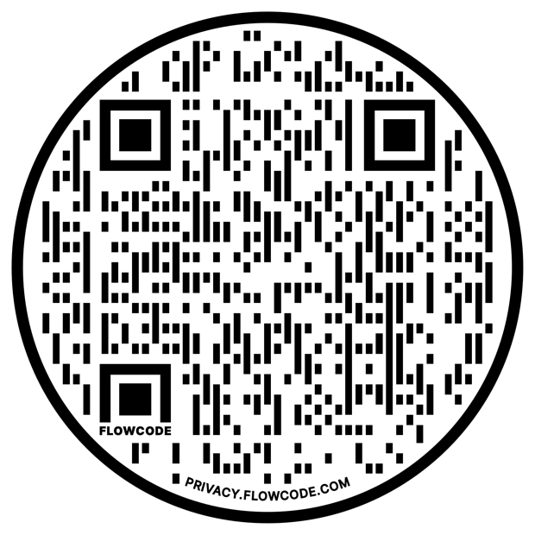
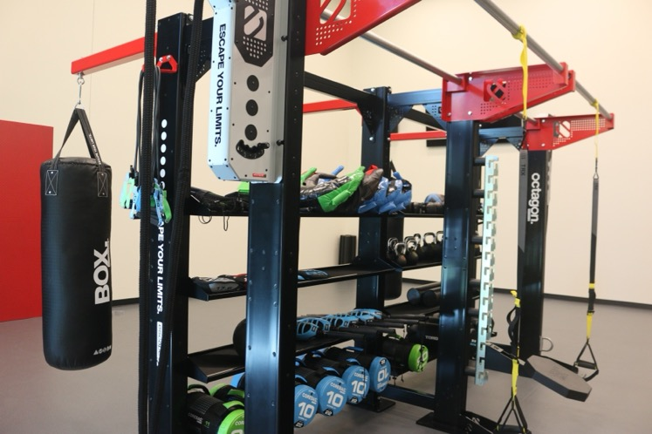
Fitness & Red Zones: open to serve the
wellness needs
of each
UH Student!
UH.EDU/RECREATION

Slide 16

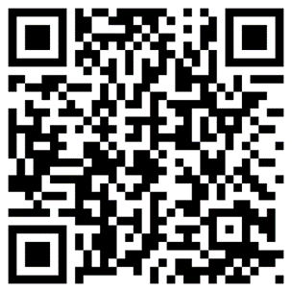
Looking for peer perspective to help you navigate college life?
Scan the QR code to learn more about Peer Assistant Leader (PAL) coaching.

Slide 17


Slide 18

welltrack boost App
We are excited to announce that UH students can join FOR FREE the community of over 1,000,000 students who have access to welltrack boost.
Download the welltrack boost app
Register for an account with your @COUGARNET.uh.edu email address

Slide 19


Slide 20

This has been your Paws Up Profs PSA.
Thank you for your attention.
Have a great semester, &
GO COOGS!

